Slide 1


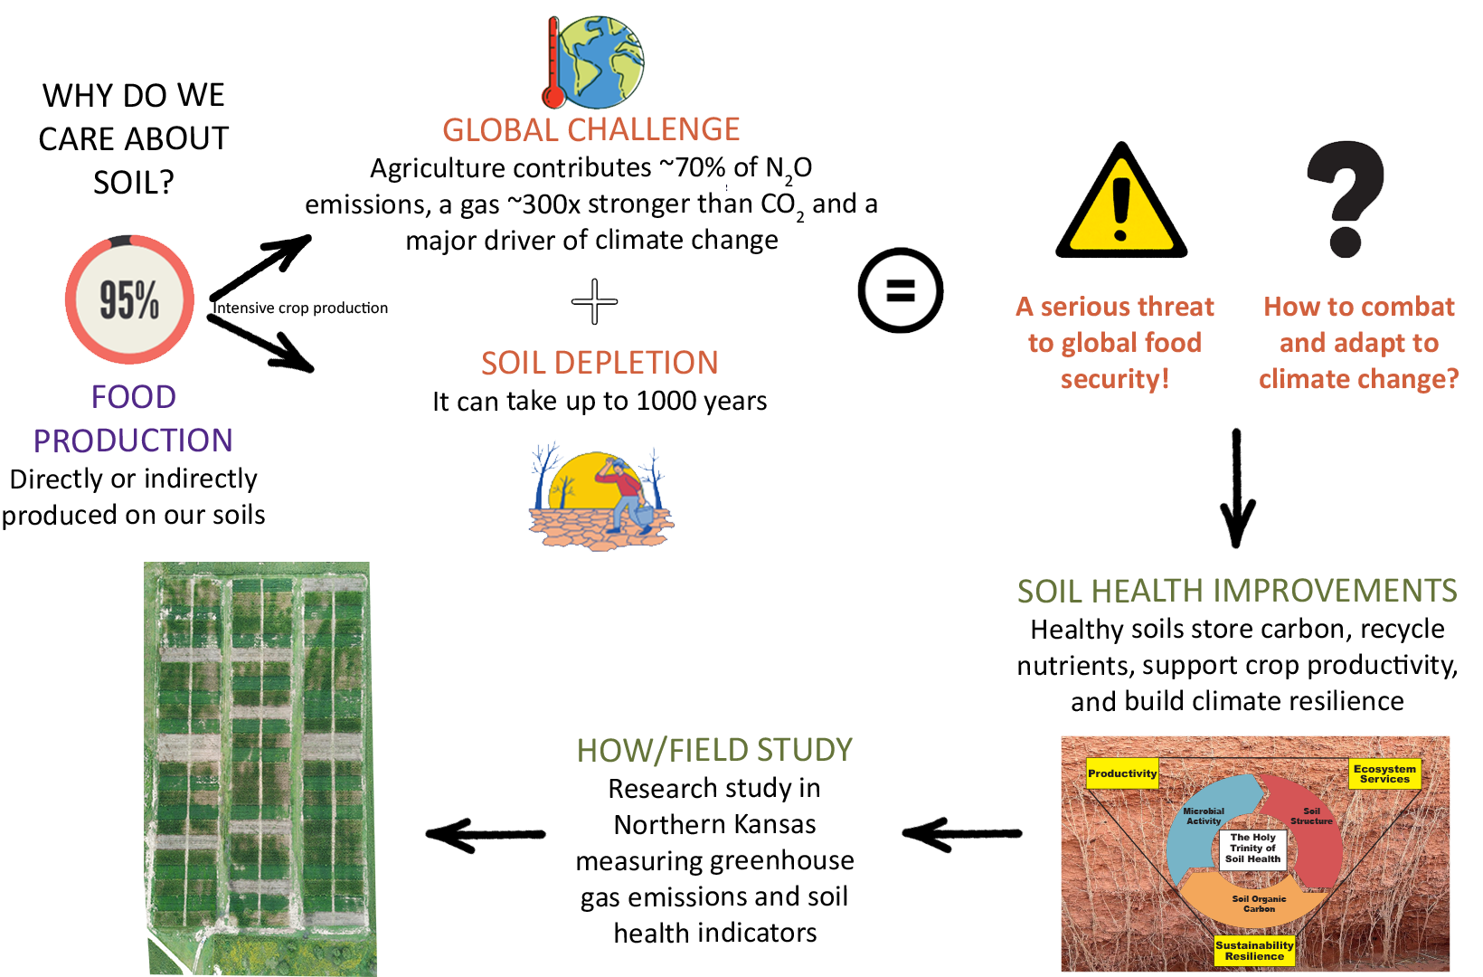
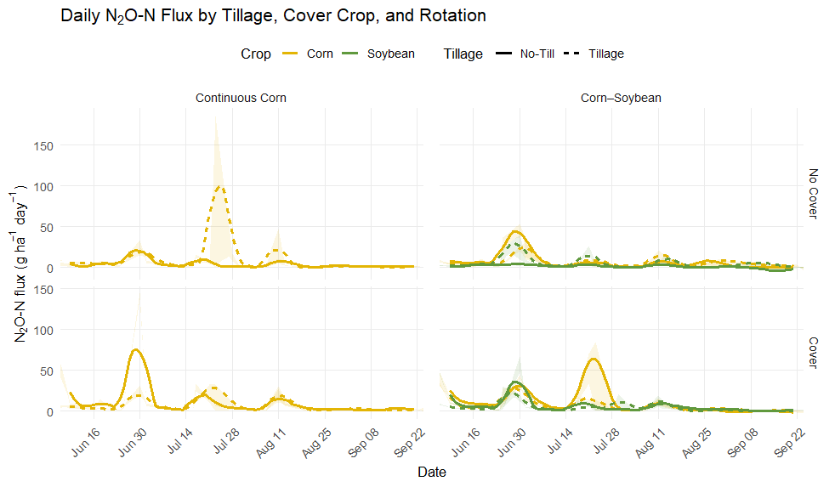



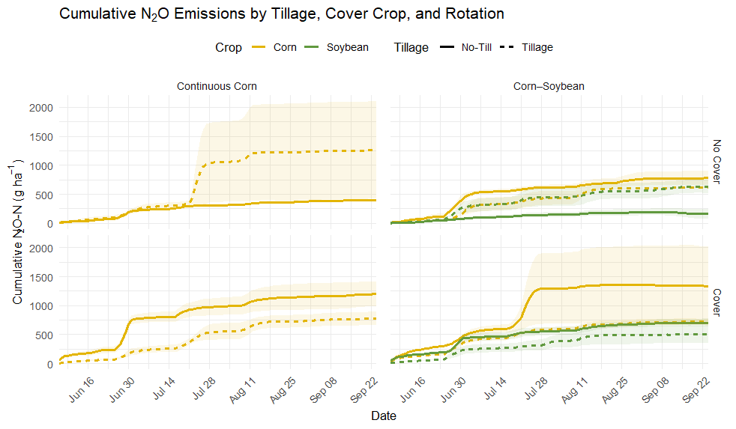
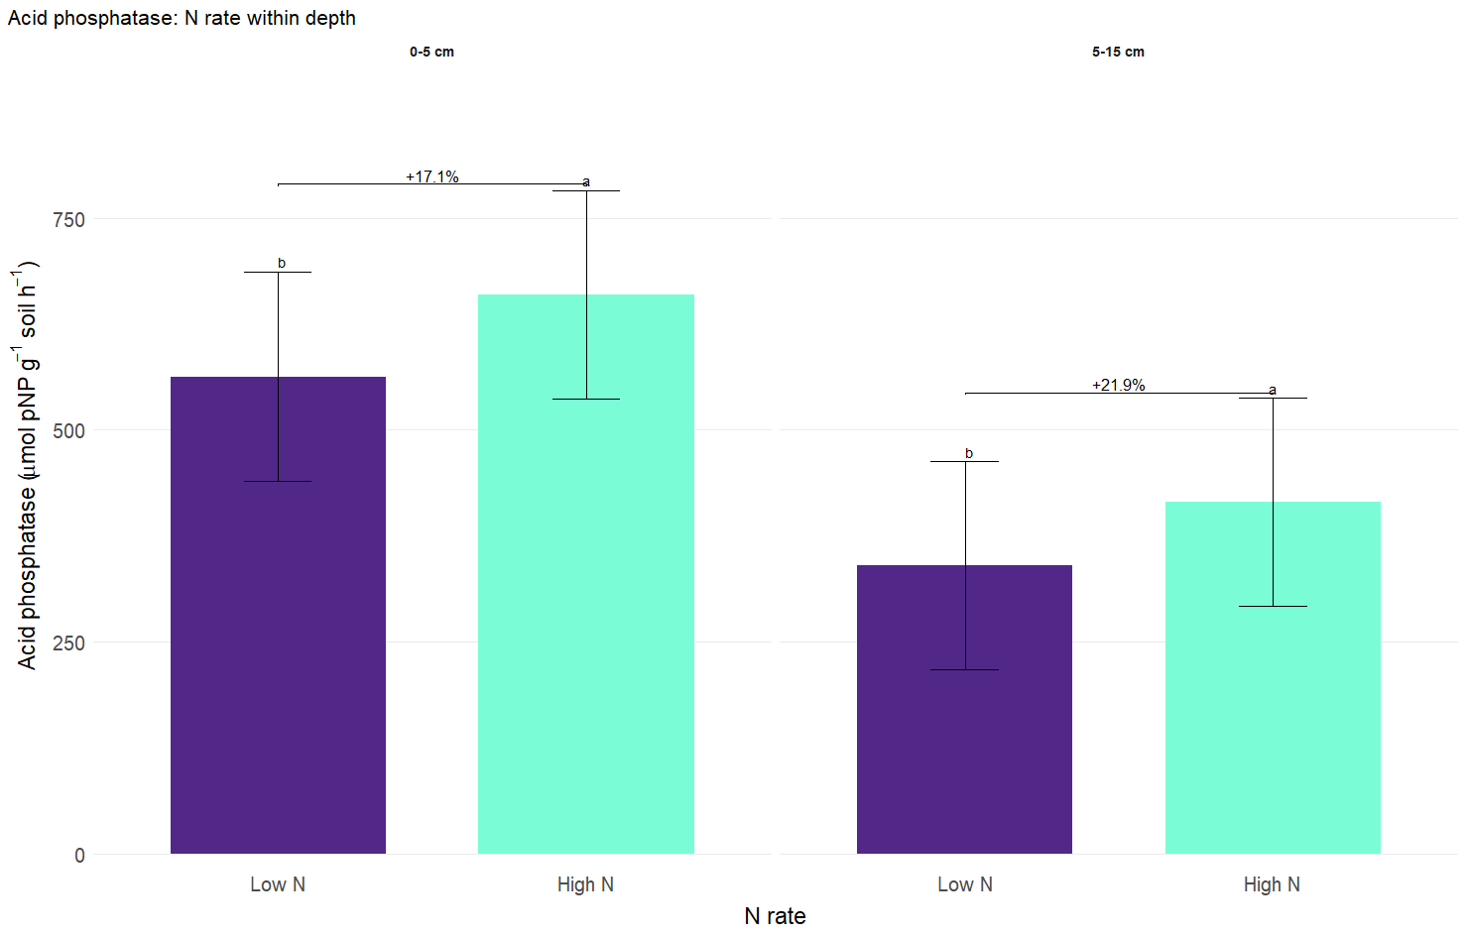
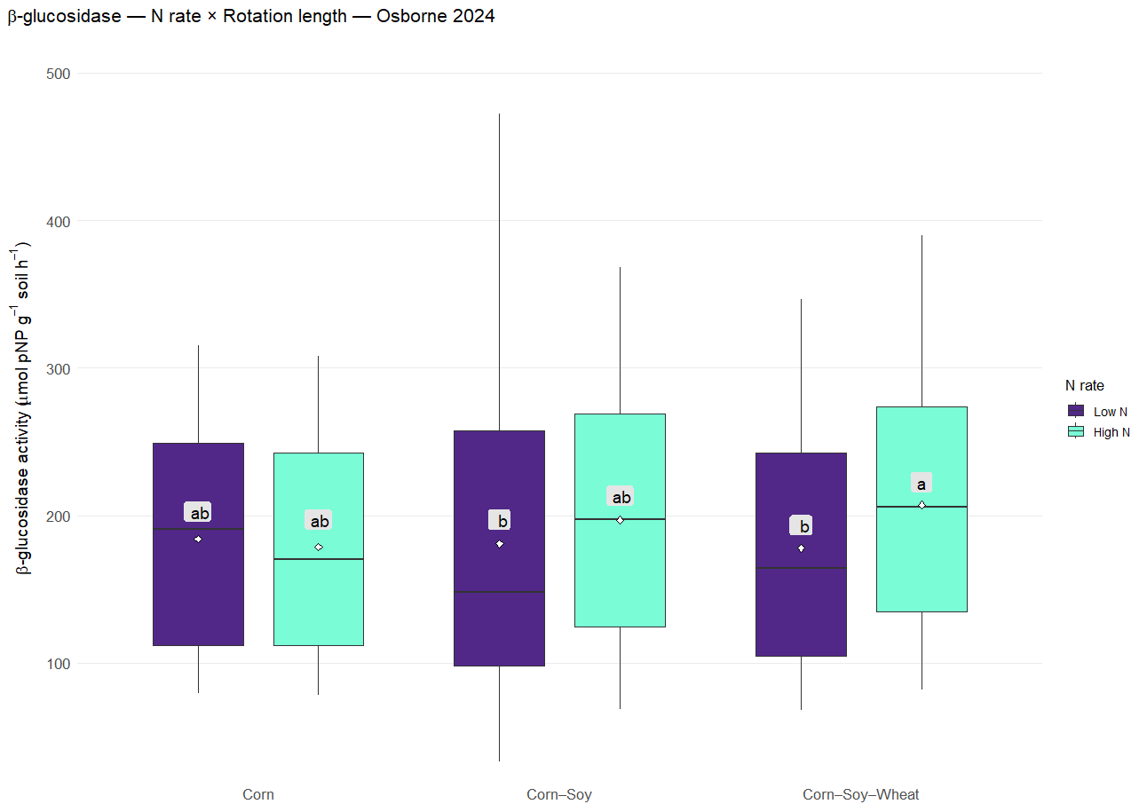



How Management Practices Shape Soil Health
and Greenhouse Gas Emissions
Wagner Squizani ¹, Augustine K. Obour¹, Dorivar Ruiz Diaz¹, and Charles W. Rice ¹
¹Department of Agronomy, Kansas State University, Manhattan, KS
BACKGROUND
RESULTS
Fig. 1. Daily N₂O Flux Patterns
Greater N₂O fluxes occurred shortly after rainfall events, lasting for ~ 2 months after planting.
The highest daily N₂O emission was observed under continuous corn under tillage and without cover crops (upper-left).
Incorporating soybean into the rotation reduced the N₂O emission intensity.
62.7 mm
20.3 mm
34.8 mm
76.2 mm
14.0 mm
28.4 mm
40.1 mm
17.3 mm
49.8 mm
25.4 mm
20.3 mm
V7
R2
V8
R1
OBJECTIVE
Fig. 2. Cumulative N₂O Emissions
Year 1 – Continuous Corn, No Cover, Tillage (upper-left):
Cumulative emissions exhibited greater variability than any other treatment.
Soybean, overall, had lower cumulative N₂O fluxes compared to corn.
Cover crop × No-till interaction (bottom row):
Increased cumulative N₂O in Year 1 and Year 3.
Assess the effects of cover crops, tillage, rotation intensity, and N rates on soil microbial diversity and N₂O flux dynamics.
HYPOTHESIS
Management practices that build soil health are expected to reduce nitrous oxide emissions.
Lonsinger – Osborne/KS
Samples for Soil Health Assessment: 2024 (baseline)
Start date for N₂O measurements: [June 6th, 2025]
LI-COR (Smart Chamber): measures N₂O fluxes
MATERIALS AND METHODS
Fig. 3. Acid phosphatase activity by management system
Fig. 4. Relationship between β-glucosidase and rotation intensity
Factor | Levels | Description
Rotation Intensity | 1-year | Corn (continuous)
 | 2-years | Corn – Soybean
 | 3-years | Corn – Soybean – Wheat
 | (All phases every year)
Nitrogen | Base | Based on historical yields
 | Increased | Additional 60 lbs/acre
Tillage | Conventional tillage | Two tillage passes in fall or spring
 | No-tillage | No tillage (or strip tillage)
Cover Crop | Yes | Cereal rye cover crop
 | No | No cover crop
Experimental Structure 6 Phases of crop rotation × 2 Nitrogen levels × 2 Tillage systems × 2 Cover crop treatments = 48 treatment combinations 48 treatment combinations × 3 replications = 144 total plots
CONCLUSIONS
Rainfall drives short-term increases in N₂O fluxes, with the highest daily emission occurring under continuous corn managed with tillage and without cover crops.
Greater cumulative N₂O emissions under cover crop × no-till systems might reflect residue decomposition and mineralization during the cash crop phase, rather than a direct effect of the cover crop itself.
Enzyme activities increased under high N and diversified rotations, suggesting enhanced microbial function and nutrient cycling.
ACKNOWLEDGEMENTS
This work was supported by the Foundation for Food & Agriculture Research under award number 22-000547. The content is solely the responsibility of the authors and does not necessarily represent the official views of FFAR.

