Slide 1

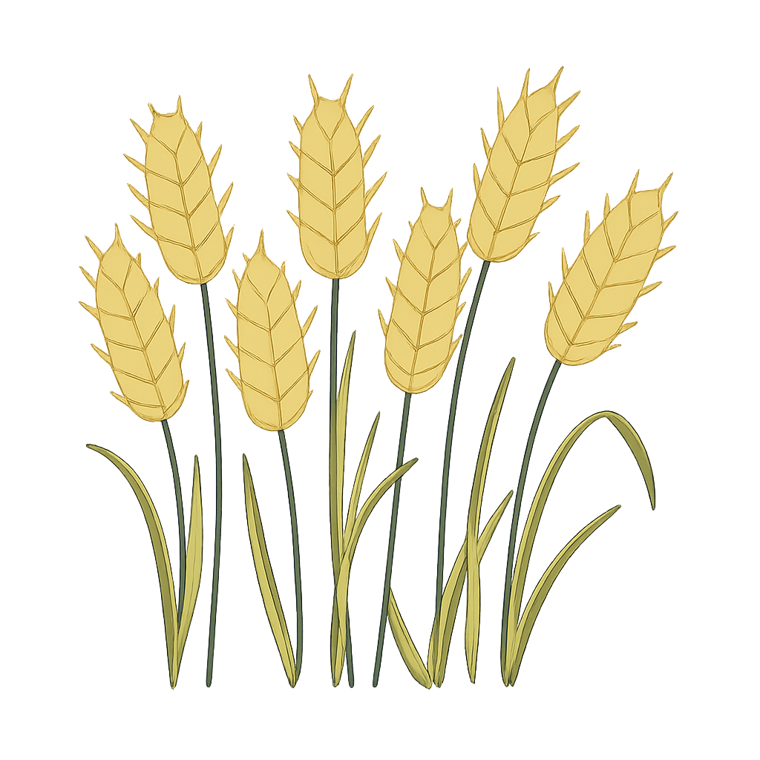
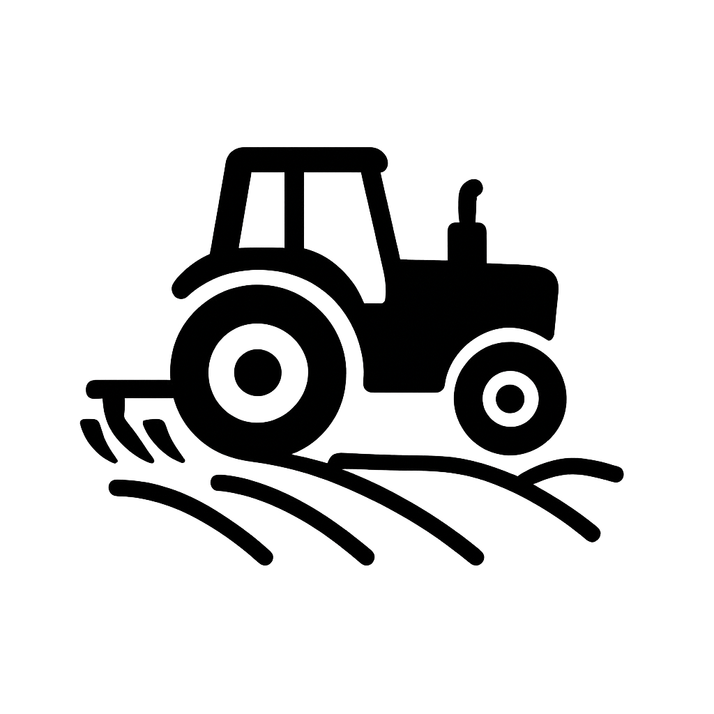
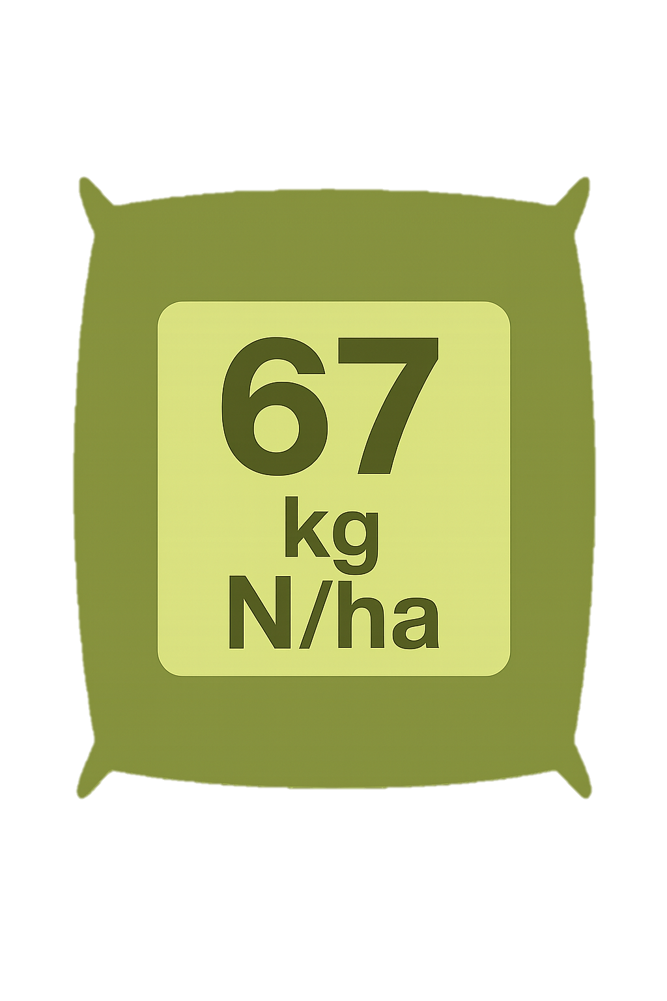

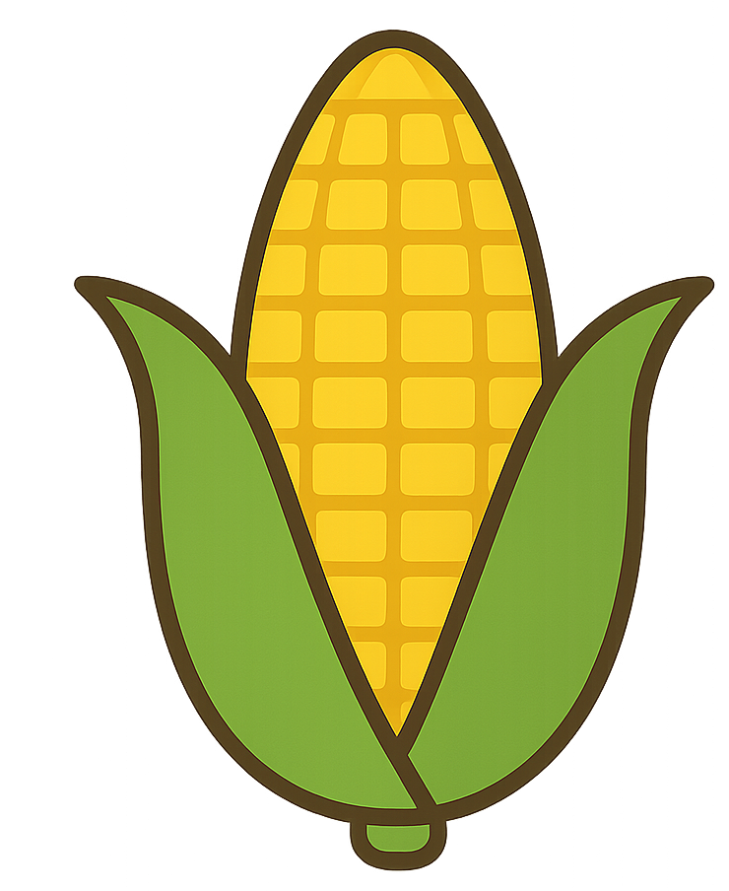
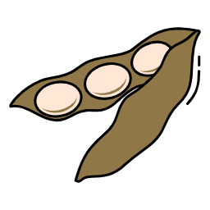

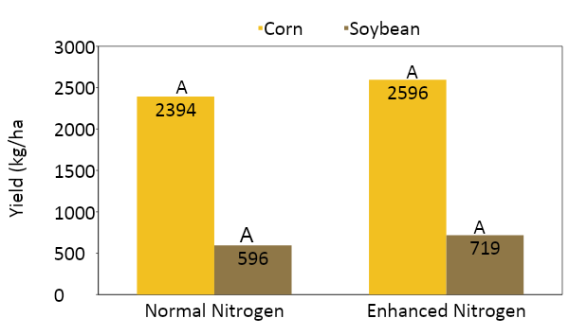
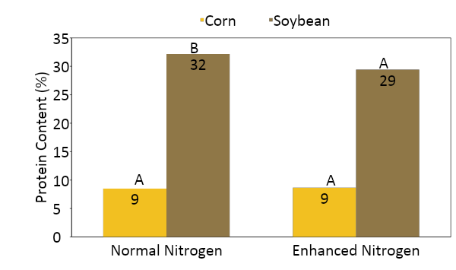
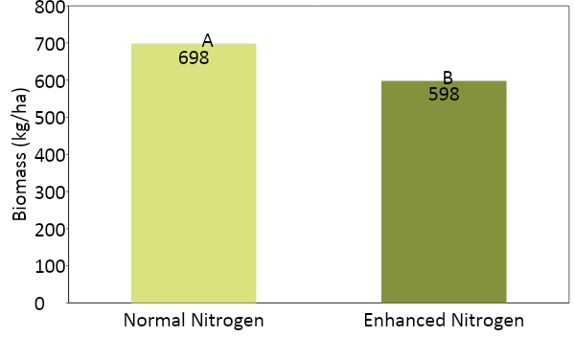
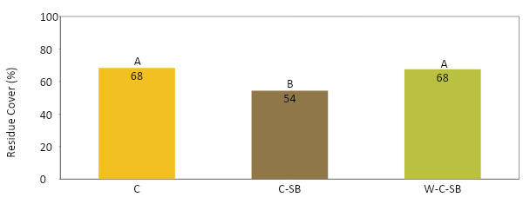
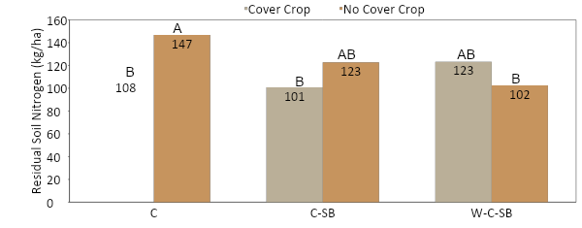




Impacts of crop management on grain yield, grain quality, cover crop biomass, residue cover, and residual nitrogen in dryland systems.
Jena Schwartze, Dorivar Ruiz Diaz, Augustine Obour, John Holman, Brian Olson, Mark Reiman, and Alexandre Tonon Rosa
Department of Agronomy, Kansas State University
Scan here!
Relevance
Methodology
Crop production relies on the interaction between management practices. Previous research had focused on one management practice rather than the interaction among multiple practices. Analyzing the interaction between management practices provides a more field-scale approach, making the research applicable to producers.
During this initial year, soybean yield data was collected using a combine harvester and adjusted to 13.5% moisture. Corn yield was determined by hand harvesting the grain and later evaluated using a DICKEY-john and adjusted to 15.5% moisture.
2024 grain N and carbon concentrations were determined using the Elementar UNICUBE after grinding the grain to 0.5 mm with a Wiley mill. The N concentration was then converted to crude protein.
2025 cover crop accumulation was determined by cutting all cover crop vegetation within a 0.6 m by 0.9 m quadrant. Three-quadrant cuttings were taken per plot. Vegetation was weighed, dried, and then reweighed to account for moisture, and total biomass accumulation was calculated.
2025 Residue Cover was determined using the line-transect method. A 3 m PVC pipe was used and marked every 0.3 m, and the residue was counted at each 0.3 m marking.
2025 residual soil nitrogen levels were determined at the Kansas State University Soil Testing Lab after collecting a 0-60 cm Giddings soil probe samples per plot in January 2025.
Objective
Determine how different nitrogen rates affect overall crop productivity, quality, and cover crop biomass.
Evaluate how crop rotation affects overall residue cover.
Analyze how both crop rotation and cover crop affect residual soil nitrogen amounts.
Experimental Location and Design
Summary of Treatments
Rye Cover Crop (CC) vs. No Cover Crop | Conventional Tillage vs. No-Tillage | Normal Nitrogen vs. Enhanced Nitrogen
Crop Rotation Intensity
Continuous Corn (C) | Corn – Soybean (C-SB) | Wheat – Corn – Soybean (W-C-SB)
This research site was established in 2024 at the Kansas State University Harold and Olympia Lonsinger Sustainability Farm in Osborne County, Kansas.
The setup was a randomized complete block design with three replications, 144 plots in total.
This is a complete factorial with three crop rotations, two tillage treatments, two cover crop treatments, and two nitrogen fertilizer application rates. See Summary of Treatments for a full description of each treatment.
This initial data does not consider the tillage treatment effect.
Results and Discussion
(A)
2024: Nitrogen Effect on Corn and Soybean Grain Yield
(B)
2024: Nitrogen effect on Crude Protein Content in Grain
(C)
2025: Nitrogen effect on Cover Crop Biomass
Figure 1: (A) There was no significant difference between nitrogen rates for corn ( p-value = 0.5365) and soybean (p-value = 0.109). (B) Corn crude protein content was not different (p-value = 0.6809). Soybean crude protein concentration decreased with the addition of nitrogen (p-value = 0.0039). (C) Cover crop biomass had a significant difference (p-value = 0.0249).
(A)
2025 Crop Rotation effect on Residue Cover Percentage
(B)
2025 Crop Rotation and Cover Crop effect on Residual Soil Nitrogen
Figure 2: (A) Given that corn and wheat residues decompose more slowly than those from soybeans, crop rotation was significantly influenced by residue cover (p = 0.0007).(B) Residual soil nitrogen levels were significantly influenced by the interaction between crop rotation and cover cropping (p = 0.0093), indicating that nitrogen retention varied across rotational and cover crop combinations.
Summary of Results
Acknowledgements
The initial data has proven that evaluating the interaction between multiple management practices has a significant effect on grain quality, cover crop biomass, residue cover, and residual soil nitrogen levels. Moving forward, this field-scale approach will be able to determine the long-term impacts of each management practice in a dryland environment.
This work was supported by the Foundation for Food & Agriculture Research under award number 22-000547. The content is solely the responsibility of the authors and does not necessarily represent the official views of FFAR.
Notes:
Yield analysis was analyzed…
Crude Protein calculated from %N content from the UNICUBE Analyzer
CC Biomass collected
How we measured residue cover
Treatment explanation (what cover crop was planted, tillage implement used, amount of nitrogen applied,
CORRECT FOR MOISTURE

