Slide 1

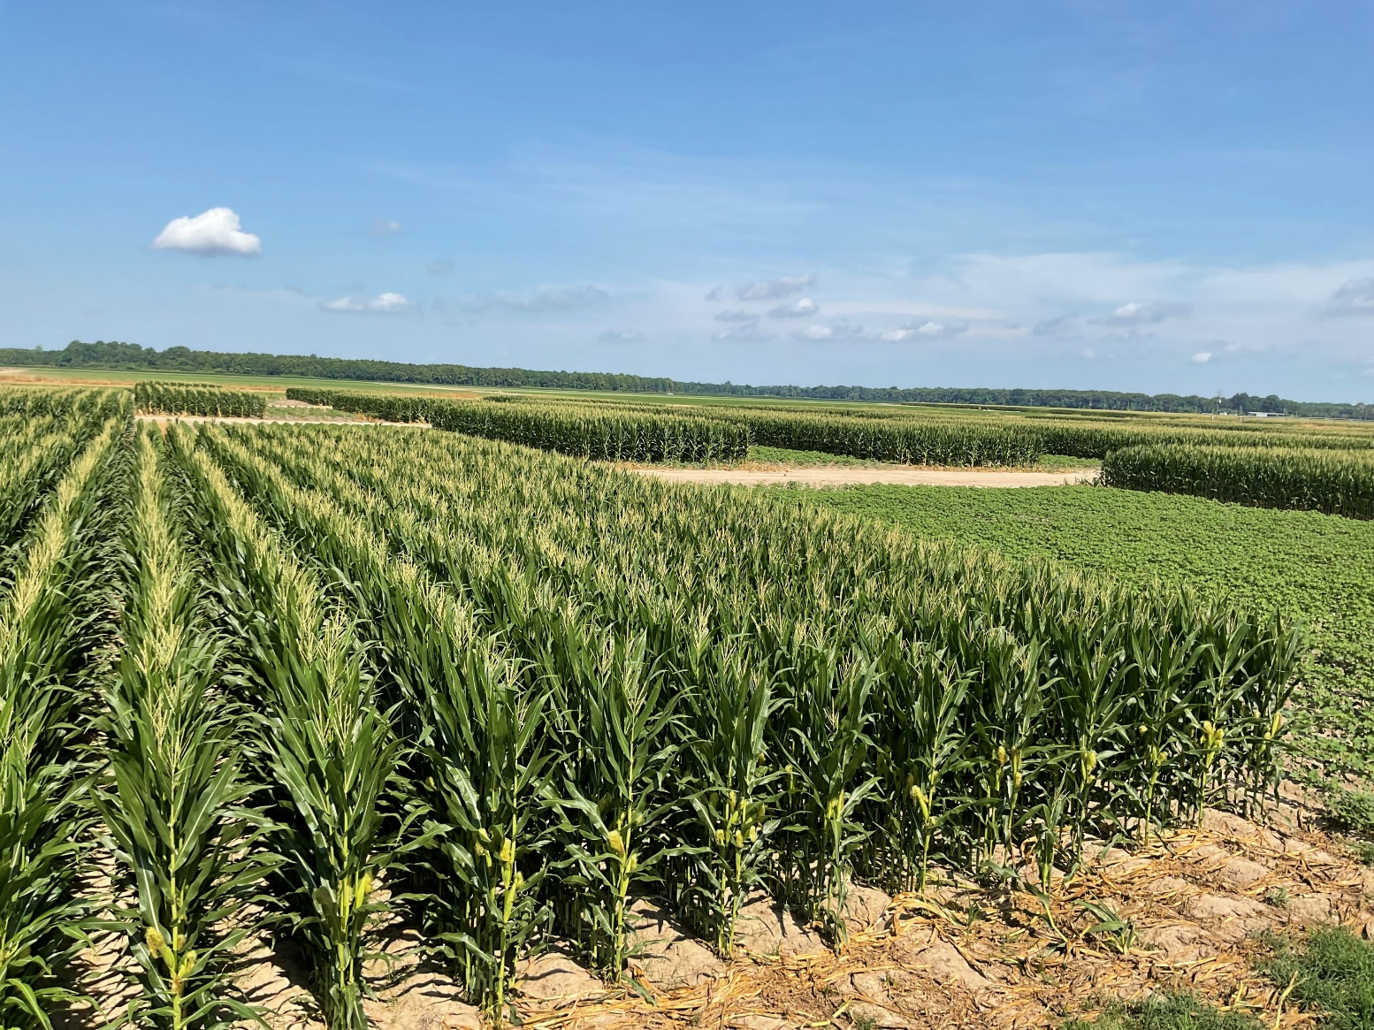
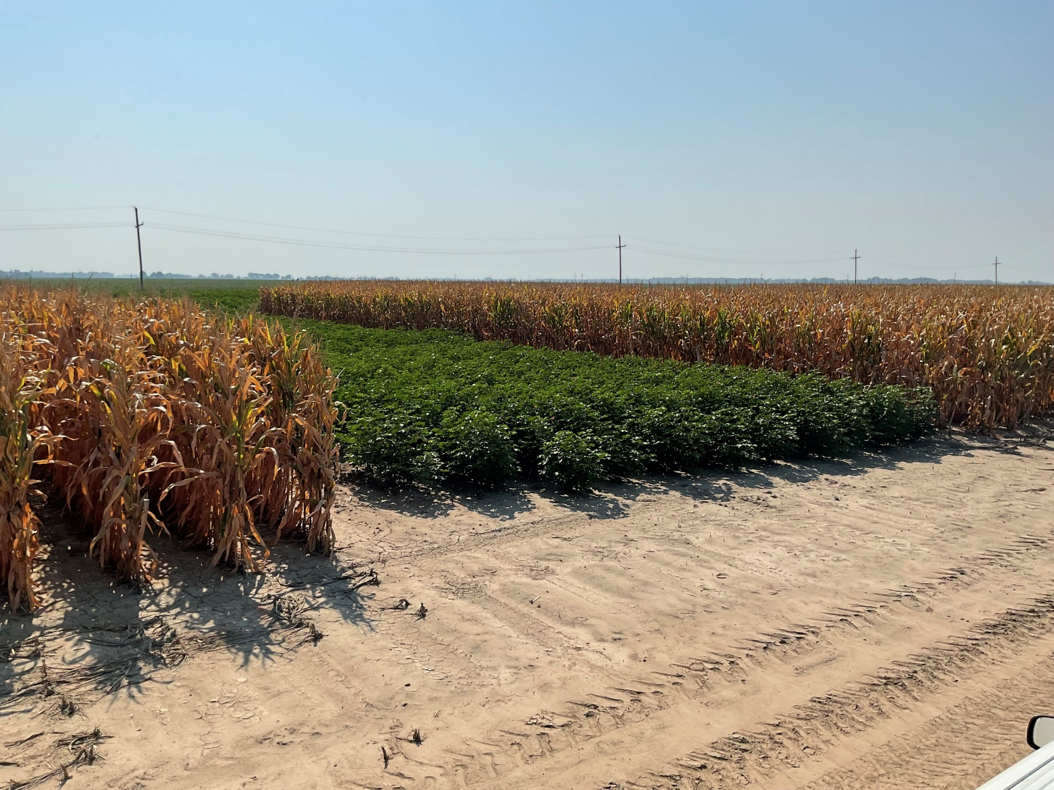
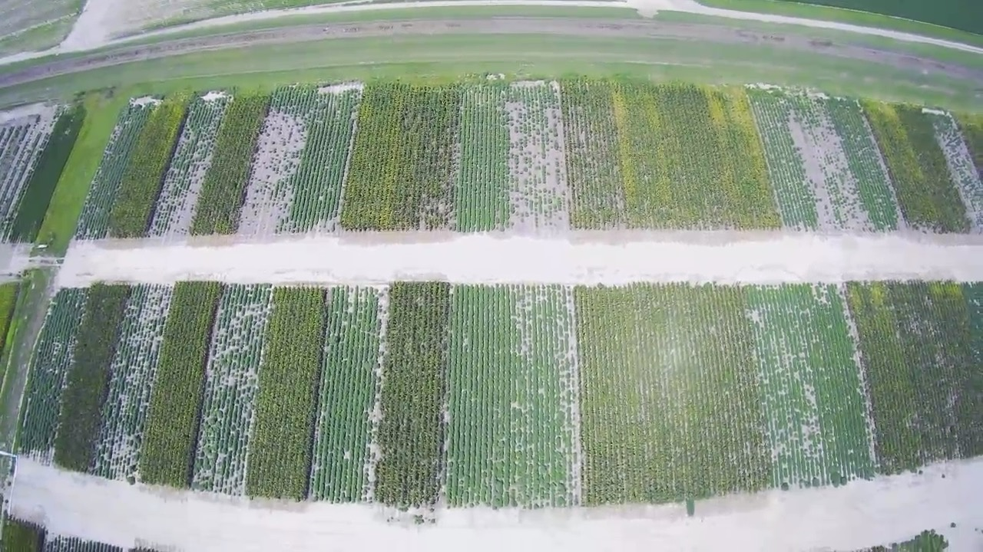
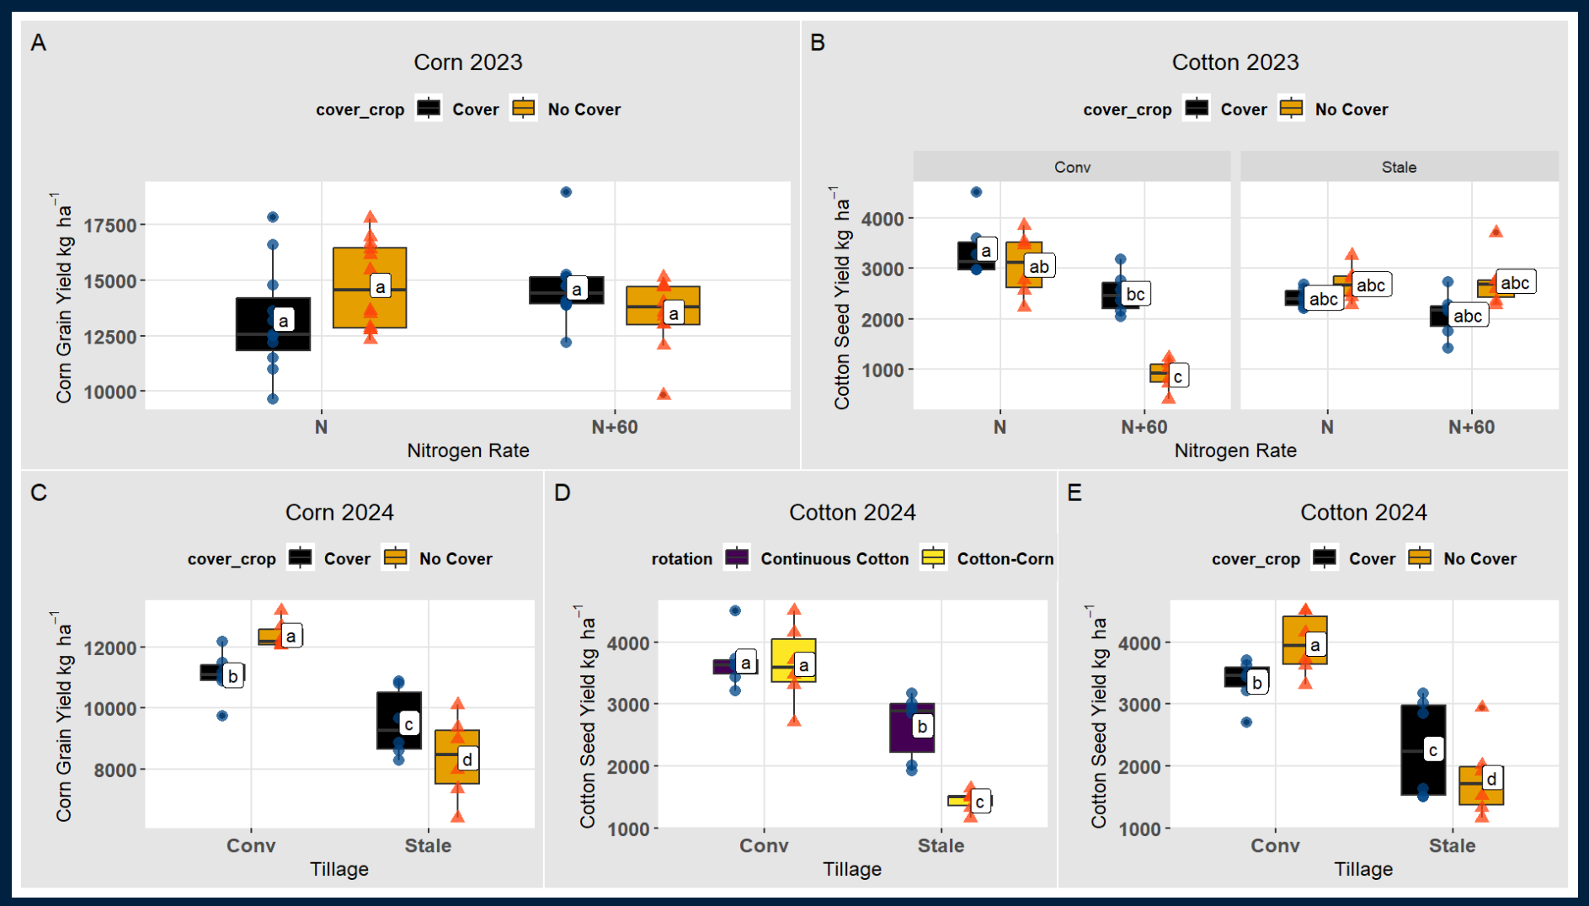


OPTIMIZING AGRICULTURAL PRACTICES: SYNERGISTIC EFFECTS OF ROTATIONS, TILLAGE, COVER CROP, AND NITROGEN
Dylan Williams*, Jay Mahaffey, Dorivar Ruiz Diaz, Jagmandeep Dhillon
Department of Plant and Soil Sciences
¹Department of Plant and Soil Sciences, Mississippi State University; FFAR, Bayer Crop Science, Kansas State University
*Email: bdw390@misstate.edu
INTRODUCTION
Increasing water productivity, soil carbon, and sustainability of croplands is imperative for the future of agricultural economy and overall farm success [1].
Most studies are limited by the number of parameters tested within a field experiment [2].
Objective: Determine the long-term impact of multi-factor experiment testing combinations of cover crops, crop rotation, nitrogen, and tillage on crop productivity and environmental sustainability.
Table 1: P-value for corn grain yield and cotton seed yield (kgha⁻¹) analyzed by main effects, two, three and four-way interactions in a study on crop rotation, cover crop, tillage (2023 & 2024) and nitrogen rate treatments (only in 2023).
 |  | Corn 2023 | Cotton 2023 | Corn 2024 | Cotton 2024
SOV | DF | p-value
Rotation (R) | 1 | 0.99 | 0.29 | 0.88 | 0.08
Nitrogen Rate (N) | 1 | 0.84 | 0.001 | -- | --
Cover crop (C) | 1 | 0.76 | 0.54 | 0.74 | 0.59
Tillage (T) | 1 | 0.90 | 0.96 | 0.007 | 0.001
R x N | 1 | 0.63 | 0.34 | -- | --
R x C | 1 | 0.46 | 0.34 | 0.46 | 0.22
R x T | 1 | 0.97 | 0.77 | 0.52 | 0.04
N x C | 1 | 0.02 | 0.07 | -- | --
N x T | 1 | 0.97 | 0.001 | -- | --
C x T | 1 | 0.80 | 0.08 | 0.001 | 0.002
R x N x C | 1 | 0.29 | 0.93 | -- | --
R x N x T | 1 | 0.08 | 0.28 | -- | --
R x C x T | 1 | 0.09 | 0.18 | 0.74 | 0.52
N x C x T | 1 | 0.73 | 0.002 | -- | --
R x N x C x T | 1 | 0.33 | 0.07 | -- | --
A
B
Fig 3: Snapshots of corn and cotton: (A) taken on June 26, 2024, and (B) on August 15,2024
RESULTS
Corn (2023): Corn yield was influenced by interaction between nitrogen and cover crops ( Fig 2A).
Cotton (2023): Cotton seed yield was significantly affected by a three-way interaction involving nitrogen, cover crop and tillage. Adding extra nitrogen reduced cotton seed yield under conventional tillage without cover crop ( Fig 2B).
Corn (2024): Corn yield was lower in strip-till systems compared to conventional, with reduction being more pronounced in plots without cover crop (Fig 2C).
Cotton (2024): Cotton seed yield was independently influenced by the interaction between tillage and rotation (Fig 2D), and tillage and cover crop (Fig 2E). Yield was lower in strip-till systems compared to conventional, with more pronounced differences in cotton-corn rotation than in continuous cotton. Additionally, yield was lower without cover crops in strip-till production systems.
Rep 4. No till + Cover Crop
Rep 3. No till + No Cover Crop
Fig 1: Birds Eye view of experiment taken on July 31, 2024, showing corn and cotton in replication 3 (no-till without cover crop) and 4 (no-till with cover crop).
MATERIALS AND METHODS
Location: Scott, Mississippi
Design breakdown: Split-plot design
  Main plot: different combination of cover crop (with or without) and tillage (conventional or strip-till)
  Subplots: defined by crop rotation (continuous corn, continuous cotton, corn-cotton, and cotton-corn) and nitrogen rate (farmer rater or farmer rate + 60 lbs.)
  Blocks – 4; Replications – 3 (within each block)
Materials: 12 row plots, corn (DKC 6835), cotton (2328 B3TXF)
Statistical analysis: Generalized linear mixed effect model using ‘lmer’ package in R and visualization using ‘tidyverse’ package.
CONCLUSION AND RECOMMENDATIONS
Additional N application effect was negligible in corn. In cotton, it was dependent on cover crop and tillage.
Positive yield effect of cover crop inclusion for both crops was only noted in strip tillage systems in 2024.
Cotton yield was lower in strip tilled plots, especially in cotton-corn rotation.
Fig 2: Corn grain yield influenced by N rate and Cover crop in 2023 (A), tillage and cover crop in 2024 (C); Cotton seed yield influenced by N rate, cover crop and rotation in 2024 (B), tillage and rotation (D), and tillage and cover crop (E) in 2024. Means with same letter are not significantly different (Tukey-test)
References
Shah, F., & Wu, W. (2019). Soil and crop management strategies to ensure higher crop productivity within sustainable environments. Sustainability, 11(5), 1485.
Clewer, A. G., & Scarisbrick, D. H. (2013). Practical statistics and experimental design for plant and crop science. Wiley & Sons.
ACKNOWLEDGEMENTS
This study is funded by the FFAR and Bayer Crop Science (Increasing Water Productivity, Soil Carbon, and Sustainability of Integrated Multi-Crop Systems Using Field-Scale Research). We thank Bayer Scott Learning team, and corn agronomics lab team for their assistance

